Slide 1
Notes:
Welcome! Thank you for taking the time to attend this Ready Now Recovery community presentation. We are Jimmy and Yvonne Oakes, Ready Now Recovery National Directors. Ready Now Recovery is a ministry of Adult & Teen Challenge. Since 1958 Adult & Teen Challenge has been a residential only program. Adult & Teen Challenge realized there was a growing need to expand the reach beyond residential. They implemented an initiative to develop a community support group ministry, which is now called Ready Now Recovery. This is a community facing resource with a support network. We want to take the next 30 minutes to share with you about Ready Now Recovery and how your community can be equipped to engage those who are struggling with life controlling issues. If you haven’t signed in yet scan this QR code.

Slide 2
‘Come, because everything is ready now…‘Go out into the highways and along the hedges, and compel them to come in, so that my house may be filled.
Luke 14:17b,23 (AMP)
Notes:
Ready Now Recovery is founded on this verse, Luke 14:17b,23. Many of you know this parable that Jesus is sharing, A man prepares this big feast for his guest and tells his servant to go and tell them that “everything is ready now…” As the servant went out, the people had many excuses as to why they couldn’t attend. We know that those who struggle with life controlling issues can find many excuses to not engage in recovery. The servant comes back and tells the master what he has heard. The master then says, “go out into the highways and along the hedges, and compel them to come in, so that my house may be filled.” One of the core components of Ready Now Recovery is outreach. We are ready for those who come, and we are ready to go out to compel those, who are not ready, to come in.

Slide 3
PURPOSE STATEMENT
Every person engaged, every community equipped, to facilitate transformation through Jesus Christ.
Notes:
Our purpose statement is this “Every person engaged, every community equipped, to facilitate transformation through Jesus Christ.” We were intentional with the word engaged because we want participants to be actively engaged in their recovery, they are doing the work we are providing the resource. Every community equipped with the vast training and resources within the ATC network. We believe in transformation and that our identity is in Christ Jesus, no labeling!

Slide 4
VISION STATEMENT
Every person impacted by life controlling issues will have access to recovery through Jesus Christ.
Notes:
Our vision statement is “Every person impacted by life controlling issues will have access to recovery through Jesus Christ.” We were intentional about the statement ‘every person impacted’ because we know that family & friends also need to be encouraged, engaged, and equipped so we provide groups for them also. Typically, our first contact is from a family member.

Slide 5
WHY READY NOW?
Accountability
Innovation
Outreach
Notes:
Why Ready Now? Accountability, Innovation, and Outreach
Accountability for the
Facilitator through
Application & Background check
Requiring 2 facilitators per group
Annual required training
Surveys for facilitation and group effectiveness
Participant
By Providing an Action plan
Through Peer to peer interaction- we encourage cross talk
Innovative by having
Virtual groups as well as in-person
3 different curriculum sources- Adult & Teen Challenge Curriculum, Select Living Free Curriculum, & Select Right Now Media.
We intentionally chose Right Now Media curriculum because there may be individuals who struggle with literacy. Because RNM is a video-based curriculum it allows the participant to engage without the shame or guilt.
Outreach is core to this ministry because we want to be intentional about going into all the world and compelling them to come in. We will discuss how we are intentional about this momentarily.

Slide 6
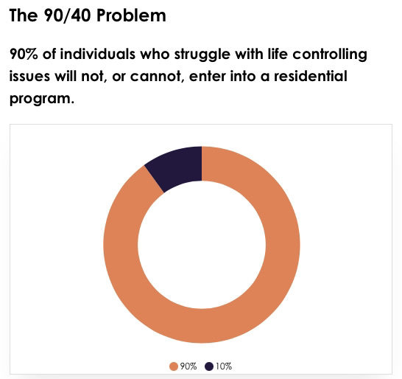
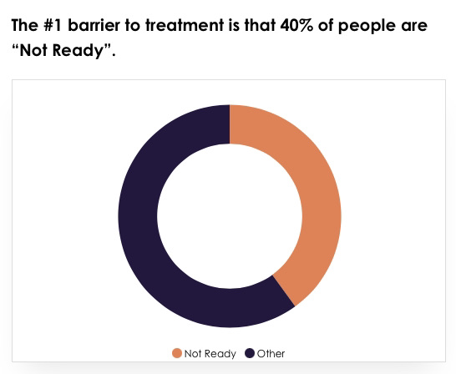
THE 90/40 SITUATION
In the U.S. over 46 million people reported they struggled with addiction and/or other life-controlling issues.
Notes:
When we began to develop RNR and researched the barriers that people face with life controlling issues we discovered the 90/40 situation. 90% of individuals cannot or will not enter a residential program. It could be for legitimate reasons, single parent who can’t leave their children or they have a job and can’t commit to a long-term residential program. The #1 barrier was that 40% were not ready to seek treatment. This was eye opening for us, we have all heard and maybe even said ourselves “well if they’re not ready than there is nothing we can do.” But as believers we couldn’t be satisfied with that statement. Going back to our verse in Luke “compel them to come in” then in Mark 16 Jesus said “Go into all the world and make disciples”. This is why Outreach is core to Ready Now Recovery.

Slide 7
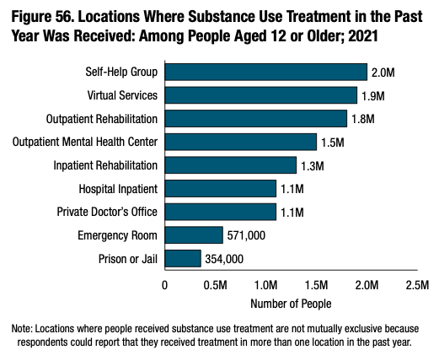
In Dec. 2022, SAMHSA announced that 46.3 million people in the US struggling with diagnosed addictions (up from 41.1 million in Substance Abuse Disorders in 2020). Support groups were the primary provider of treatment for those surveyed.
According to the latest data from SAMHSA
Notes:
As you can see from these statistics support groups were the primary provider of treatment. Even at that ,out of the 46.3 million, only 2 million attended support groups, 1.9 million attended virtual services, and 1.3 million went into residential programs. We have to make recovery options more accessible.

Slide 8
THE SOLUTION: "ACCESSIBILITY"
ESTABLISH
Weekly Community Support Groups both in-person and virtually
INITIATE
Outreach by partnering with other non-profits to serve, build relationships, love, encourage, educate, and invite to groups.
Notes:
Ready Now Recovery is committed to accessibility. We are establishing weekly community support groups both in-person and virtually and we are initiating outreach by partnering with other non-profits, churches, ATC centers to build relationships, love, encourage, educate, and invite to groups.

Slide 9
VALUES
TRANSFORMATION
How long will it take? What if I fail? When will I be free? All of these questions are a part of the transformation process. Through a Christ centered perspective, a loving community, and relevant resources, our groups will guide you through that process of transformation.
ACCESSIBILITY
Affordability, location, relevance, safety, and resources are essential to transformation. We are committed to providing diverse curriculum for affordability and relevance. We offer safe spaces with both in-person and virtual groups. We have resources for referral to professional care and residential programs.
Notes:
RNR has four core values:
Transformation- through Jesus Christ
Accessibility- safe locations (in-person & virtual), relevant curriculum, vast network of resources for referral (pastoral counseling, professional counseling, approved ATC outpatient and residential programs).

Slide 10
VALUES
OUTREACH
We all know there are those who are not ready, so what can we do to help them in the process of becoming ready? Partnering with other non-profits weekly to serve, love, encourage, educate, and build relationships, fosters organic invitations to attend groups.
COMMUNITY
Recovery is more than an individual journey. It takes a community — and it makes a community. It isn’t always easy, but we can always do it together. We are committed to equipping community leaders to establish groups.
Notes:
Outreach- when we regularly commit to partner with other non-profits, where the not ready community would be, we can have the opportunity to build lasting relationships and encourage their movement from not ready, to recognizing they have life controlling issues, to being invited to a group, to attending a group where they can accurately assess what they need for recovery in a safe community.
Community is vital for all of us, we want to equip communities to have healthy community and safe spaces for individuals to assess recovery.

Slide 11
PARTICIPANT-CENTERED PROGRAM
ATC APPROVED CURRICULUM
PROGRAM LENGTH
ACTION PLAN
Notes:
RNR is a participant-centered program, meaning there is no set length of time that an individual is committed to attend. They are able to view the groups available and choose which one meets their needs. Typically, what happens is that such community is created in these groups that they want to continue on with another group. While in a group they also can discover that they have other issues that they may need to address and will continue with other groups that addresses those issues.
A group can last on average 6-8 weeks, and they can be in more than one group per week. This is why we added the virtual component so an individual can get into a group anytime and day of the week. Groups are affordable for the participant; it can range anywhere from $10- $25/per 6-8wk group.
Each participant is given an action plan workbook which helps them to identify where they are in the stage of change, identify triggers, assess friendships and family relationships, set goals (spiritual, educational, employment, and relational), referral resources, and build their team with mentors, counselors, support groups, and local church.

Slide 12
Ready Now Recovery has incorporated courses within five different categories. These five categories will provide education which will promote healthy lifestyles.
Spiritual Growth
Life Skills
Emotional Intelligence
Social Development
Addiction Education
Notes:
RNR has curriculum for the groups that cover five categories for a healthy lifestyle. Spiritual growth, Life skills, emotional intelligence, addiction education, and social development.

Slide 13
RESOURCES
IN PERSON GROUPS
COMMUNITY LOCATIONS
VIRTUAL GROUPS
SOBER PEER APP
REFERRALS
HOTLINES
PASTORAL COUNSELING
PROFESSIONAL COUNSELING
RESIDENTIAL TREATMENT
EDUCATION REFERRALS
GED
COLLEGE
TRADE SCHOOL
MINISTRY
LOCAL CHURCH CONNECTION
ACTION PLAN
Notes:
These are the resources that we provide for participants.
IN PERSON GROUPS
COMMUNITY LOCATIONS
VIRTUAL GROUPS
SOBER PEER APP
REFERRALS
HOTLINES
PASTORAL COUNSELING
PROFESSIONAL COUNSELING
RESIDENTIAL TREATMENT
EDUCATION REFERRALS – Action plan
GED
COLLEGE
TRADE SCHOOL
MINISTRY
LOCAL CHURCH CONNECTION

Slide 14
TRAINING
TEAM
Administers the program in the community. A location can start with
2 trained facilitators. But over time we will help build your team.
Notes:
RNR Facilitators are required to have two trained facilitators in each in-person group for integrity and accountability. A community could start an RNR ministry with as little as two volunteers. Then RNR would help build the team in the community so more groups could be offered.

Slide 15
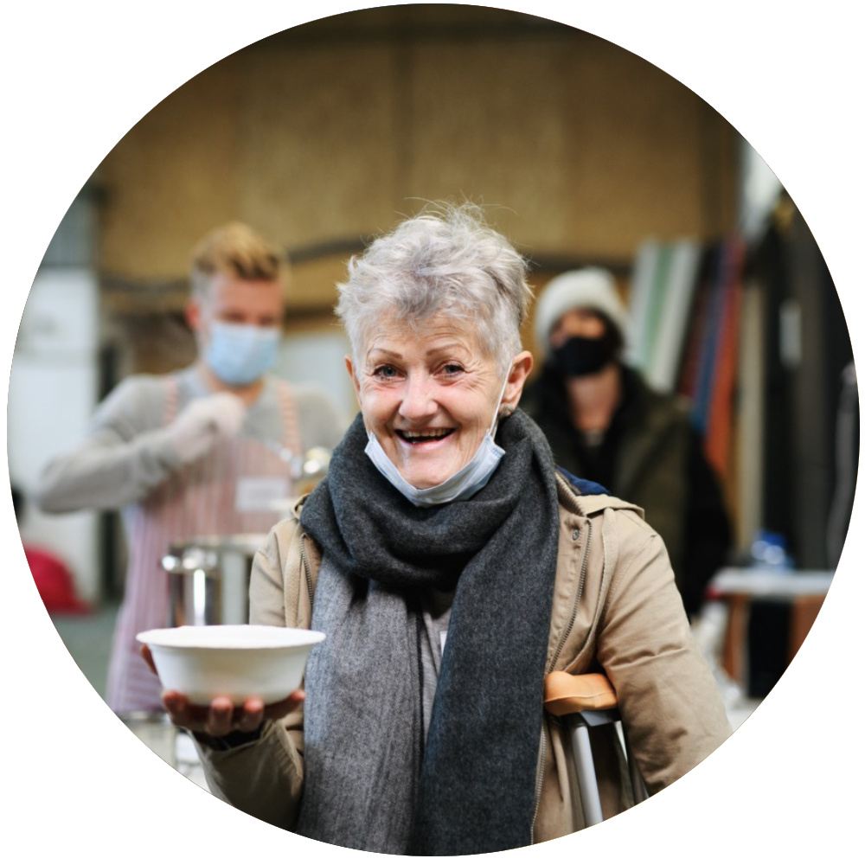
TRAINING
OUTREACH TEAMS
These teams will be trained in Evangelism and Discipleship. Having intentional focus on the 40% that "are not ready".
Partnering with ATC centers for outreach ministry
Partnering with local churches for outreach
Partnering with local non-profits for outreach
Notes:
RNR has a very robust and intentional training for all of our facilitators. A core element to our training is to equip each team to go into their community regularly, at least once a month, for outreach.

Slide 16
TRAINING
FACILITATOR COURSE PLAN
RNR Group Dynamics Course
Breaking Free
Understanding and Supporting Healthy grief
Confidentiality
Child Abuse & Neglect Prevention / Reporting
Loving Your Community
Disciples are Made Not Born
7 - week group participation
Notes:
RNR robust facilitator training consist of the following course plan of 25+ hours
RNR Group Dynamics Course
Breaking Free
Understanding and Supporting Healthy grief
Confidentiality
Child Abuse & Neglect Prevention / Reporting
Loving Your Community
Disciples are Made Not Born
7 - week group participation
We want to ensure that our facilitators are equipped to facilitate groups and are trained to do no harm, recognize and resource with referral for extended care.

Slide 17
SUBSCRIPTION
$100 Annually
OR
$10 Monthly
$20 initial first month set up fee
Application and Background check $30 (nonrefundable)
Curriculum cost not included in subscription. This is on avg. apx $100 (you can create a library for training curriculum to be shared not copied).
Notes:
RNR facilitator training and certificate is based on a subscription model.
$100 Annually OR $10 Monthly
$20 initial first month set up fee
Application and Background check $30 (nonrefundable)
Curriculum cost not included in subscription. This is on avg. apx $100 (you can create a library for training curriculum to be shared not copied).

Slide 18
SUBSCRIPTION INCLUDES:
Certification Card - Identifies you as an approved Ready Now facilitator/trainer
Welcome packet - Includes brochures, ATC resources, Support team contact information, etc...
Annual training - Access to ongoing training, required annual training, and advanced training
Advanced Training- AACC courses offered at a discount
Updated curriculum - We are regularly writing new curriculum which can be offered as new groups
Discount - You will receive a discount for select ATC curriculum
Resources - Referrals to hotlines, counseling services, and residential centers
Team Support - ongoing access to team and tech support
RightNow Media – Access to unlimited video-based curriculums
Bridge- Access to the Ready Now Recovery Learning Management System
Notes:
The subscription is a great value for all that you receive.
Certification Card - Identifies you as an approved Ready Now facilitator/trainer
Welcome packet - Includes brochures, ATC resources, Support team contact information, etc...
Annual training - Access to ongoing training, required annual training, and advanced training
Advanced Training- AACC courses offered at a discount
Updated curriculum - We are regularly writing new curriculum which can be offered as new groups
Discount - You will receive a discount for select ATC curriculum
Resources - Referrals to hotlines, counseling services, and residential centers
Team Support - ongoing access to team and tech support
RightNow Media – Access to unlimited video-based curriculums
Bridge- Access to the Ready Now Recovery Learning Management System

Slide 19
ADVANCED TRAINING
Mental Health Coach First Responder - AACC Course
Grief and Loss Coaching – AACC Course
Addictions and Recovery A&R 2.0 – AACC Course
Leading Small Groups Basics and Advanced – AACC Course
Motivational Interviewing - Currently in development and will be an ATC training curriculum with Dr. Pingleton
AACC- American Association of Christian Counselors
Added fees for advanced courses
Notes:
These are some of the advanced course options that an RNR facilitator would have access to with incredible discounts.
Mental Health Coach First Responder - AACC Course
Grief and Loss Coaching – AACC Course
Addictions and Recovery A&R 2.0 – AACC Course
Leading Small Groups Basics and Advanced – AACC Course
Motivational Interviewing

Slide 20
FOLLOW US ON
readynow.org
@readynowrecovery
Ready Now Recovery
Notes:
You can find out more about RNR at readynow.org and you can follow us on Instagram and facebook

Slide 21
Notes:
At this time, we would like to ask if there are any questions?
Thank you for attending and if you have any other questions, please contact us.
If you are interested in becoming a facilitator scan this QR Code for more information.

